Slide 1
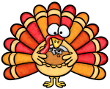
THANKSGIVING
1
What’s the name of this holiday?
THANKSGIVING
HALLOWEEN
BONFIRE NIGHT
Notes:
1

Slide 2
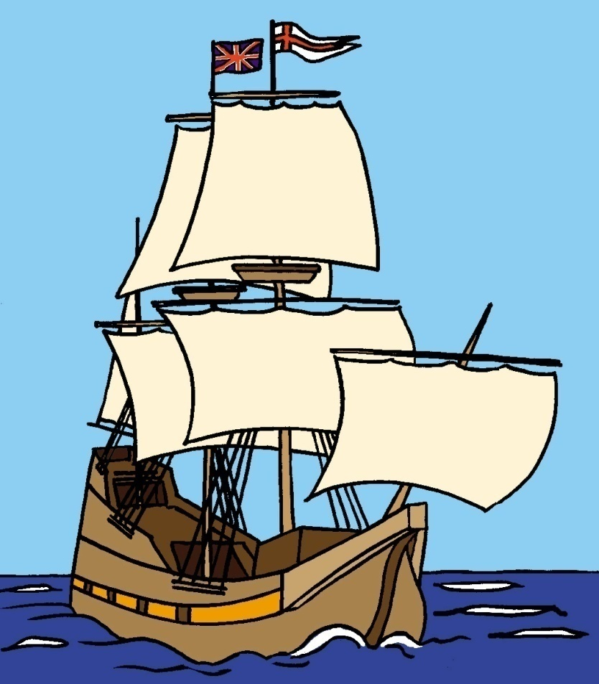
THANKSGIVING
2
What’s the name of this ship?
TITANIC
MAYFLOWER
QUEEN MARY
Notes:
2

Slide 3
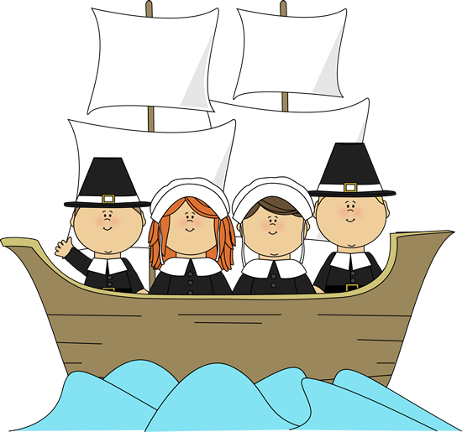
THANKSGIVING
3
Who are they?
SAILORS
PIRATES
PILGRIMS
Notes:
3

Slide 4
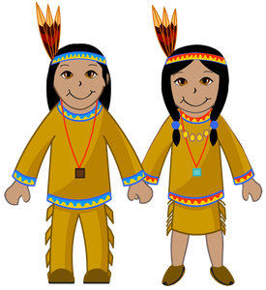
THANKSGIVING
4
Who are they?
VIKINGS
HUNS
INDIANS
Notes:
4

Slide 5
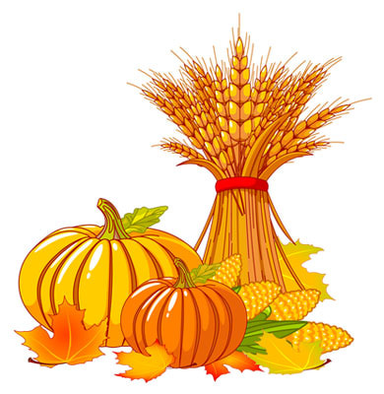
THANKSGIVING
5
What’s this?
GARDENING
HARVEST
FOREST
Notes:
5

Slide 6

THANKSGIVING
6
What’s this?
CORNUCOPIA
FOREST
SPRING
Notes:
6

Slide 7
THANKSGIVING
7
What’s this?
TURKEY
DUCK
GOOSE
Notes:
7

Slide 8
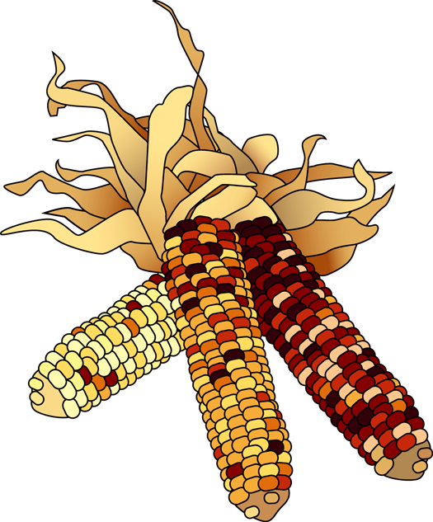
THANKSGIVING
8
What’s this?
WHEAT
RYE
CORN
Notes:
8

Slide 9
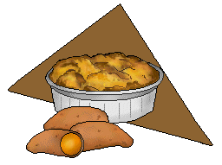
THANKSGIVING
9
What’s this?
HAM
YAM
MEAT
Notes:
9

Slide 10
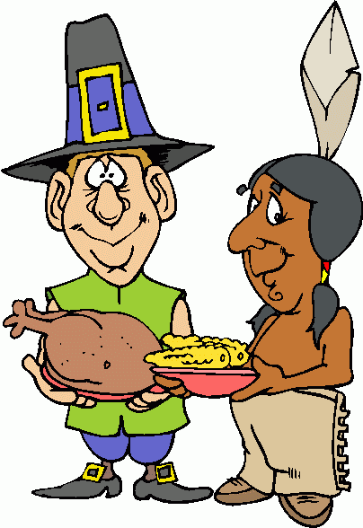
THANKSGIVING
10
What’s this?
HUNTING
FISHING
FIRST THANKSGIVING
Notes:
10

Slide 11
THANKSGIVING
11
What’s this?
BIRTHDAY
PARTY
THANKSGIVING
DINNER
SUNDAY
LUNCH
Notes:
11

Slide 12
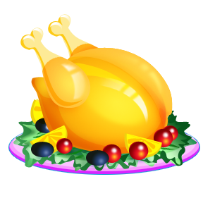
THANKSGIVING
12
What’s this?
ROAST CHICKEN
ROAST BEEF
ROAST TURKEY
Notes:
12

Slide 13
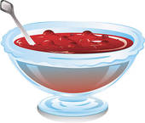
THANKSGIVING
13
What’s this?
ICE-CREAM
CRANBERRY SAUCE
GRAVY
Notes:
13

Slide 14
THANKSGIVING
14
What’s this?
PUDDING
PUMPKIN PIE
APPLE PIE
Notes:
14

Slide 15

15
Notes:
15

